Slide 1
When do Christmas songs pop into your mind? Testing a long term priming hypothesis
Lia Kvavilashvili and Sue Anthony
University of Hertfordshire

Slide 2
Involuntary Musical Mind-pops
Songs and melodies that come to mind spontaneously
Irrelevance to current situation
  E.g. singing American Anthem while in the exam

Slide 3
Repetitive earworms
Songs and melodies that get stuck in one’s to mind
Disturbing and disruptive
Notes:
Interesting depictions of earworms in media/internet
Analogy with IAMs and Intrusive Memories.
Interesting questions: How many time does ordinary musical mind-pop repeat to qualify being earworm?
Also are earworms really unpleasant or disruptive?

Slide 4
Involuntary Semantic Memories
(Kvavilashvili & Mandler, 2004)
Fragments of semantic knowledge that come to mind spontaneously without any deliberate attempt to recall them

Slide 5
Involuntary Semantic Memories
(Kvavilashvili & Mandler, 2004)
words, images or melodies/songs
No contextual information
Absence of triggers

Slide 6
Prevalence of mind-pops: An Interview Study
(Kvavilashvili & Ford, in preparation)
Age group | Sample N=134 | % of females
5-year olds | N= 31 | 55%
7-year olds | N=33 | 58%
9-year olds | N=34 | 53%
Adults | N=36 | 72%

Slide 7
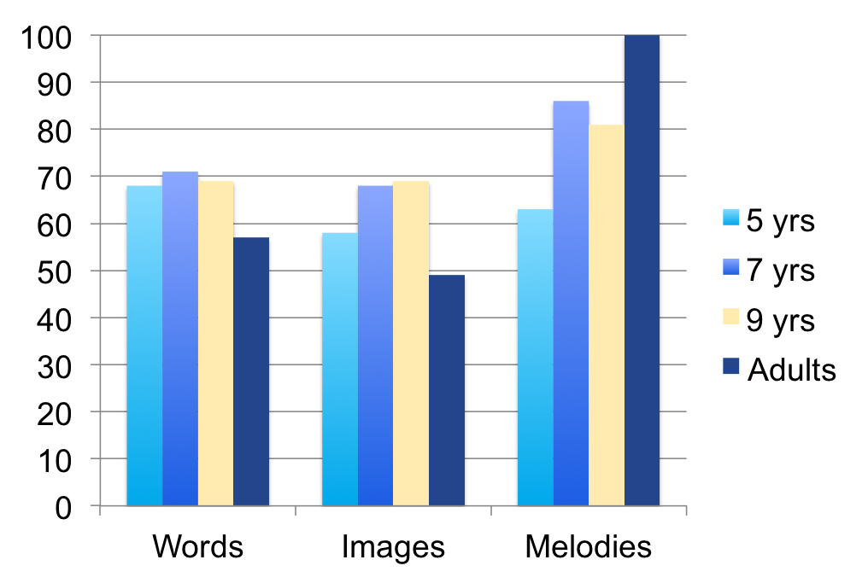
Percentages of participants reporting different types of mind-pops
WORDS – χ ² = 1.68, df = 3, p = .64
IMAGES – χ ² = 3.68, df = 3, p = .29
MELODIES – χ ² = 15.19, df = 3, p = .002
Notes:
Age effect for melodies emerges only for adults and 5-year old children

Slide 8
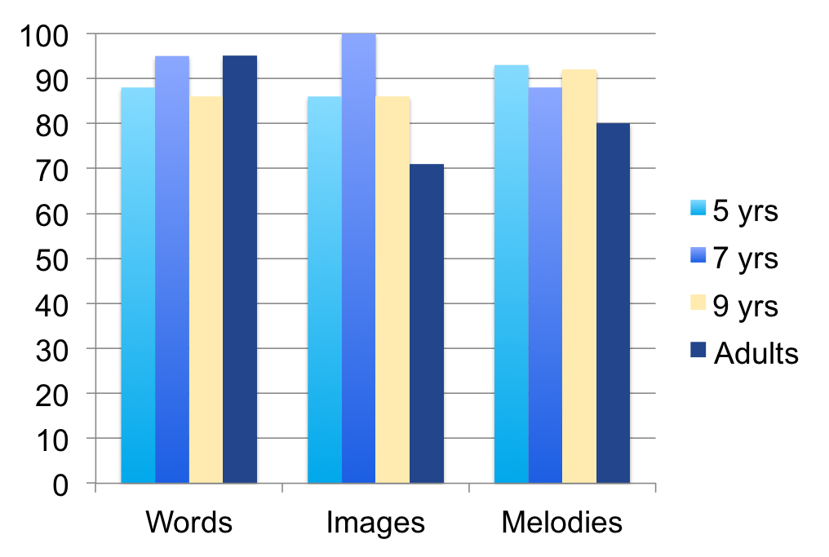
Percentages of participants providing examples of different types of mind-pops
WORDS – χ ² = 1.60, df = 3, p = .66
IMAGES – χ ² = 6.49, df = 3, p = .09
MELODIES – χ ² = 2.70, df = 3, p = .44
Notes:
Age effect for melodies emerges only for adults and 5-year old children

Slide 9
 | Examples of Verbal Mind-Pops
5 years | Words that I’ve heard but don’t know what they mean Friends’ names – Laura, Bora The word ‘bagel’
7 years | Words that I have previously learnt pop into my head My nan’s name, my friend ‘Joseph’s’ name An unusual word Baby names because my mother is pregnant
9 years | The word ‘epiphany’ My friend’s name ‘Whitney’ When I was eating McDonalds, the name ‘George’ popped into my head
Adults | Random friends’ names When I am writing an essay and a random word pops into my head that has nothing to do with essay I am drinking tea and the name ‘Nick’ pops in my head When I was shopping, the word ‘nursery’ popped into my head

Slide 10
 | Examples of Image Mind-Pops
5 years | Image of Spongebob, an image of “Hello Kitty” An image of cat A really big slide
7 years | Selena Gomez, Pink Panther, pictures of a particular class, Gadget boy, the staff room at school A game I had when I was a baby – A white square with a red square inside
9 years | Bart Simpson, football players, Spongebob, image of a train, pieces of art I have drawn and the playground
Adults | Pictures of people, images from football, pictures of buildings from my holiday, the image of my room at home or university

Slide 11
 | Examples of Musical Mind-Pops
5 years | I started singing “Twinkle twinkle little star” The school song, Harry Potter song, football songs, Bob the builder song, songs I learnt at singing club, songs by Olly Murs
7 years | If I hear my brother playing the flute during the day I will hum the tune, French song that we learnt, our school song, when I was playing football a song popped into my head, the song from my ballet class-it’s the butterfly song, songs by Lady Gaga
9 years | Song from the concert, Fireworks – Katy, songs from cartoons, songs by Adele, Katy Perry-ET during my lessons at school, the song ‘Dinamite’ by Taio Cruz, when I listen to music on radio it will then pop into my head later on in the day, usually class
Adults | Around Christmas time, various Christmas songs come into my head, wake up in the morning and a song is in my head, on the bus and a random song will pop into my head, recurring tune from dance Macabre that I studied at school seem to keep popping into my head

Slide 12
Research on Mind-pops
Kvavilashvili & Mandler (2004)
  JEP: General
Elua, Kvavilashvili & Laws (2012)
  Psychiatry Research
Zhang, Li, Wei, Yang et al. (2015)
  Brain Imaging and Behavior

Slide 13
Research on Musical Mind-pops and earworms
Bailes (2007)
Brown (2006)
Baruss & Wammes (2009)
Beaman & Williams (2010), (2013)
Byron & Fowles (2013)
Floridou & Müllensiefen (2015)
Halpern & Bartlett (2011)
Hyman et al. (2013)
Liikanen, (2008; 2009; 2012)
Müllensiefen et al. (2014)
Williamson et al. (2012)
Williamson & Jilka (2013)

Slide 14
When and Why do we have mind-pops?
They are not completely random
What pops into mind has been directly or indirectly experienced in recent past
  In 42 - 49% of recorded mind-pops, recent encounters with the content of the mind-pop were reported (Kvavilashvili & Mandler, 2004)

Slide 15
Long-term priming hypothesis
(Kvavilashvili & Mandler, 2004)
Things encountered result in lasting activations of their representations in semantic memory
Subsequent activations from some other stimuli may further re-activate already activated representations resulting in a mind-pop

Slide 16
Experimental support for the priming hypothesis (Coane & Balota, 2009)
Standard Lexical Decision Paradigm
Captured pre-existing activations of words in the lab
  At Christmas time words ‘turkey’, ‘tree’, ‘deer’ had shorter RTs than at other times of year

Slide 17
Aims of present research
Examine long-term priming by studying musical mind-pops
To see if Christmas songs more likely to pop into mind during Christmas period than other times
  Further inspiration from Halpern & Bartlett’s (2011)
  Diary study of earworms

Slide 18
Method
Keeping a diary of musical mind-pops
1 week in early November
1 week in December (week before Xmas)
1 week in early February
  Standard diary and instructions

Slide 19
Method
2 studies in 2011/2012 and 2012/2013
Study 1 – N=15
  Mean age = 29.07,SD= 12.78, range 19-50
Study 2 – N=27
  Mean age = 22.19, SD=6.74, range 19-51

Slide 20
Number of recorded musical mind-pops ?
 | November | December | February | F value | p value
STUDY 1 Total N Mean SD Range | 133 8.87 (4.75) 4 – 17 | 132 8.80 (4.66) 0 – 17 | 121 8.07 5.68 0 – 20 | .18 | .84
STUDY 2 Total N Mean SD Range | 305 11.30 (6.44) 2 – 24 | 243 9.00 (6.04) 1 – 22 | 293 10.85 (7.07) 1 – 23 | 2.52 | .10

Slide 21
Ordinary mind-pops or repetitive earworms?
Number of repetitions
 | 0 | 1 | 2 | 3 | 4 +
Study 1 (same day repetition) | 59% (228) | 15% (58) | 15% (57) | 6% (24) | 5% (19) | 100% (386)
Study 2 (same day repetition) | 79% (661) | 13% (113) | 5% (43) | 2% (15) | 1% (8) | 100% (840)
Study 2 (repetitions on subsequent days) | 80% (675) | 10% (86) | 5% (49) | 3% (20) | 1% (9) | 100% (840)
Notes:
The first two rows represent percentages of musical mind pops that were recorded on a diary page and participants did not indicate experiencing them again on the same day by putting a tick (or ticks) on the bottom of the diary page (0 repetitions) or they had additional ticks (1, 2, 3, 4+)
The third row presents data from Study 2 where participants additionally put ticks on a dedicated space if a particular recorded mind-pop repeated again on subsequent days.
Even if we adopt fairly lenient criterion of what counts as an earworm (the occurrence of the same musical mind pop at least 3 times) the percentages of reported earworms in both studies are quite low.

Slide 22
Priming hypothesis:
More Christmas songs in December?
 | Nov | Dec | Feb | Friedman’s Test | p value
STUDY 1 Total N Mean Proportion SD | 0 0.00 (.00) | 29 21.87 (17.54) | 1 0.48 (1.84) | χ² = 21.41 (2,15) | .00001
STUDY 2 Total N Mean Proportion SD | 1 0.15 (0.77) | 33 13.96 (20.13) | 4 0.93 (2.38) | χ² = 27.44 (2,27) | .00001

Slide 23
Priming hypothesis:
Percentage of recent encounters
STUDY 1 | Encountered (Primed) | Not encountered | Total
Non-Christmas mind-pops | 32% (114) | 68% (240) | 100% (354)
Christmas mind-pops | 82% (22) | 18% (5) | 100% (27)
Total | 36% (136) | 64% (245) | 100% (381)
χ² (1,381)= 31.18, p<.0001

Slide 24
Priming hypothesis:
Percentage of recent encounters
STUDY 2 | Encountered (Primed) | Not encountered | Total
Non-Christmas mind-pops | 34% (271) | 66% (520) | 100% (791)
Christmas mind-pops | 76% (25) | 24% (8) | 100% (33)
Total | 36% (296) | 64% (528) | 100% (824)
χ² (1,824)= 65.32, p<.00001
Notes:
60-70% reported to occur within last 48 hours. Further 15-20% within the current week (so on 3-5 days).

Slide 25
Exposure to music
Spearman’s Correlations
 | Active listening to music | Passive listening
November No of mind-pops | r=.10 p=.64 | r=.20 p=.33
December No of mind-pops | r=.01 p=.96 | r=.47* p=.015
February No of mind-pops | r=.24 p=.24 | r=.45* p=.02

Slide 26
Reported triggers in Study 1

Slide 27
Reported triggers in Study 2

Slide 28
Summary of results
High prevalence of musical mind-pops
Distinction between musical mind-pops and earworms
Support for long-term priming hypothesis
  Proportion of Christmas songs in December
  Christmas songs more likely reported to be encountered in recent past
  Positive correlations between the number of mind-pops and passive exposure to music

Slide 29
IMPLICATIONS
For research on priming
Relationship between musical mind-pops and other types of mind-pops
  Are they same phenomenon or different?
  Vehicle for studying Involuntary Semantic Memories
Relationship between musical mind-pops and earworms
  What turns a musical mind-pop into earworm?
  Any difference between earworms and verbal perseverations?

Slide 30
Questions/Issues
When and why do we experience musical
mind-pops?
Need to separate distal and proximal causes
  Long term priming
  Immediate cues or triggers
  Some potential confusion about cues and long term primes
Relationship between triggers and priming
  Do we need both to elicit a mind-pop?

Slide 31
Acknowledgements:
To Christina Thomas &
Sophie Aston
For helping with data collection in the Interview study of mind-pops
To Francesca Spong,
Samantha Wright, &
Christina Dembenezi
For collecting data for
Studies on Christmas songs

